Slide 1
Indian Institute of Information Technology, Pune.
Department of Computer Science and Engineering.
Digital Certificate Verification using Blockchain

Slide 2
Topics of the presentation
Prerequisites
Introduction to problem statement
Literature review
Objectives
Proposed Solution
Drawbacks

Slide 3
Prerequisites
Understanding of Blockchain Technology
SHA-256 Algorithm
Blockchain Platforms
Smart Contracts

Slide 4
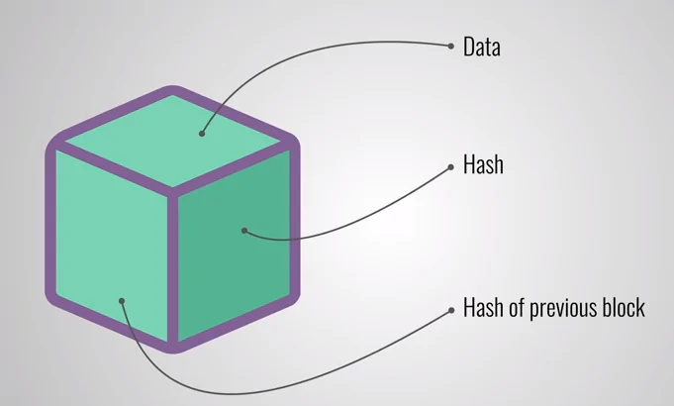
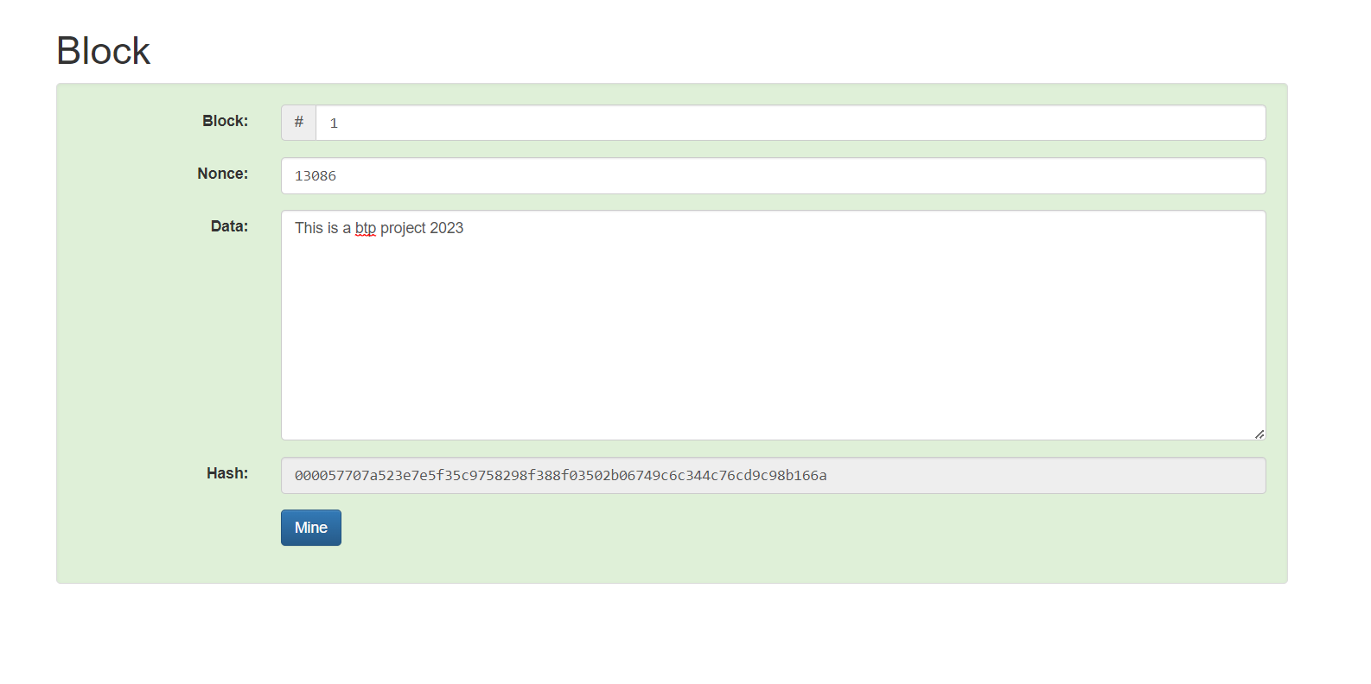
What is a Block ?
A block in blockchain is a digital record that contains a list of data and a unique code, called a hash, that links it to the previous block in the chain.

Slide 5
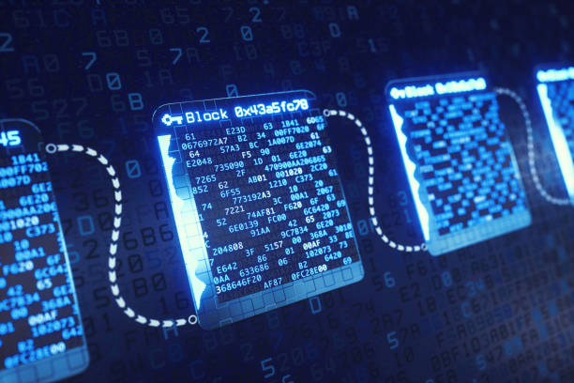
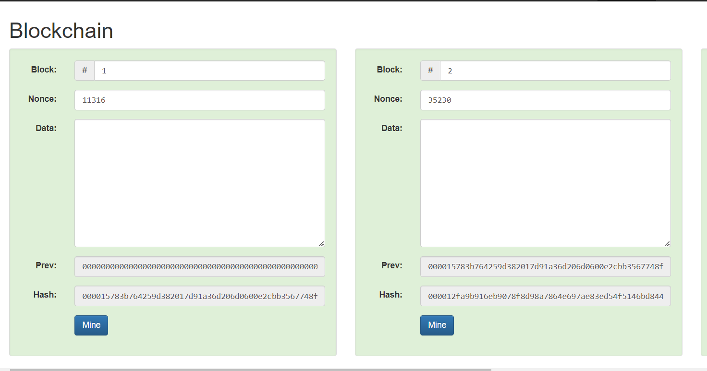
What is Blockchain ?
A blockchain is a database of transactions that is updated and shared across many computers in a network. Every time a new set of transactions is added, its called a “block” - hence the name blockchain.

Slide 6

SHA 256 Algorithm
SHA-256 is a cryptographic hash algorithm that takes any input and produces a 256-bit (32-byte) output.It works by applying a series of mathematical operations to the input The output is unique and irreversible, meaning that it is very unlikely that two different inputs will produce the same output, and that it is impossible to recover the input from the output.

Slide 7
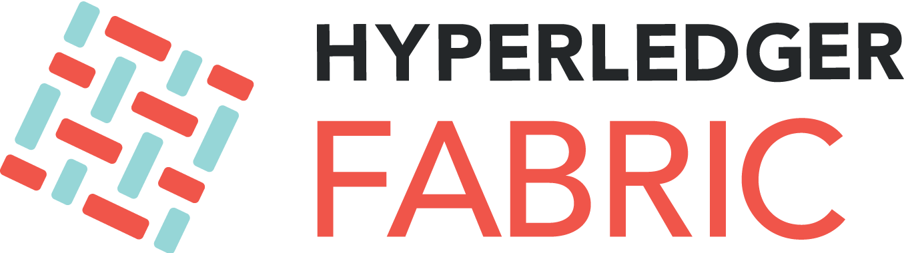


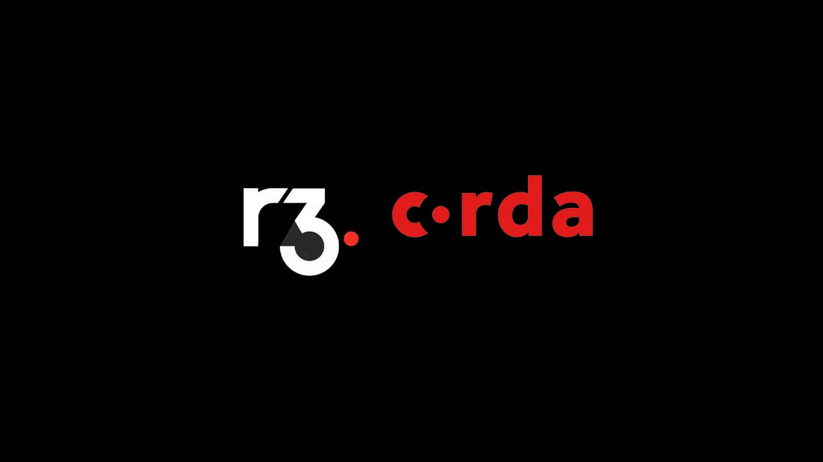
Blockchain Platforms
A blockchain platform is a software system that allows users to create and manage applications that use blockchain technology. A blockchain platform provides the tools and infrastructure for developing various types of applications, such as cryptocurrencies, smart contracts, decentralized applications (DApps), non-fungible tokens (NFTs), and more..

Slide 8

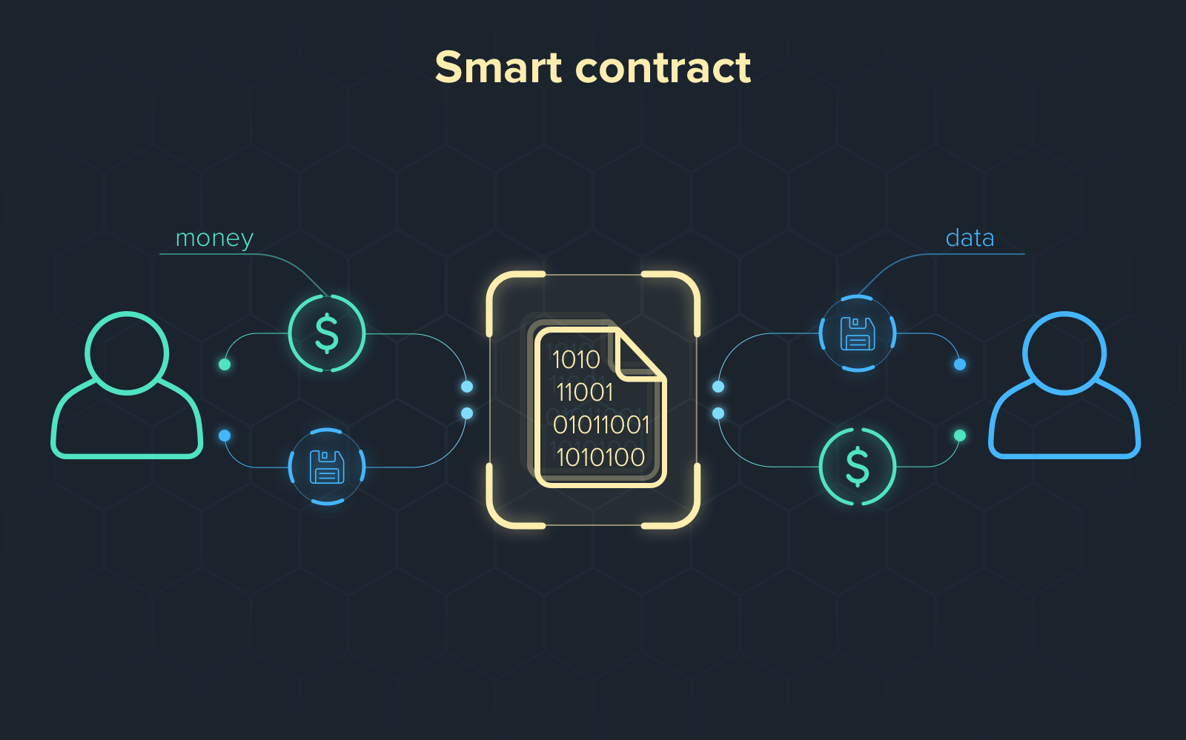
Smart Contracts
A smart contract is a digital agreement that automatically executes itself when certain predetermined conditions are met.

Slide 9
Introduction to Problem Statement
The traditional digital certificate verification system suffers from issues such as certificate fraud and identity theft, leading to mistrust between parties.
A blockchain-based digital certificate verification system can address these issues by providing a tamper-proof and decentralized system for storing and verifying digital certificates. The system could use digital signatures and cryptographic algorithms to ensure certificate authenticity and prevent tampering, thereby increasing trust and transparency in industries such as education and job placement.

Slide 10
Literature Review
[1] Giandari Maulani 1 ,Gunawan 2 , Leli 3 , Efa Ayu Nabila 4 , Windy Yestina Sari 5,”Digital Certificate Authority with Blockchain Cybersecurity in Education” International Journal of Cyber and IT Service Management (IJCITSM) Vol. 1 No. April 2021.
[2] U. Rahardja, A. S. Bist, M. Hardini, Q. Aini, and E. P. Harahap, “Authentication of Covid-19 Patient Certification with Blockchain Protocol.”
[3] P. A. Sunarya, U. Rahardja, L. Sunarya, and M. Hardini, “The Role Of Blockchain As A Security Support For Student Profiles In Technology Education Systems,” InfoTekJar J. Nas. Inform. dan Teknol. Jar., vol. 4, no. 2, pp. 13–17, 2020.

Slide 11
Objectives
Ensuring the authenticity and validity of certificates
Streamlining the verification process
Enhancing security and reducing fraud

Slide 12
Proposed Solution
The Python program has the following steps:
Takes any file as input and converts it to its binary form.
Takes the information related to the certificate that is being worked on and converts it to binary.
Adds both the binary data and generates a unique hash value of 64 characters using the SHA_256 algorithm.
The generated hash value along with user information is taken as data and:
Put on the blockchain.
This process is done using Corda IDE.

Slide 13
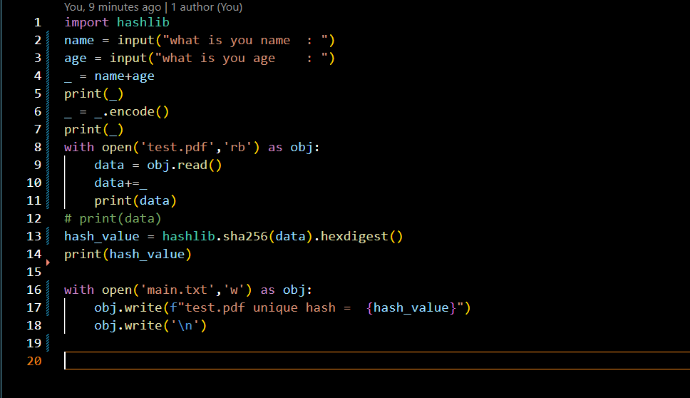
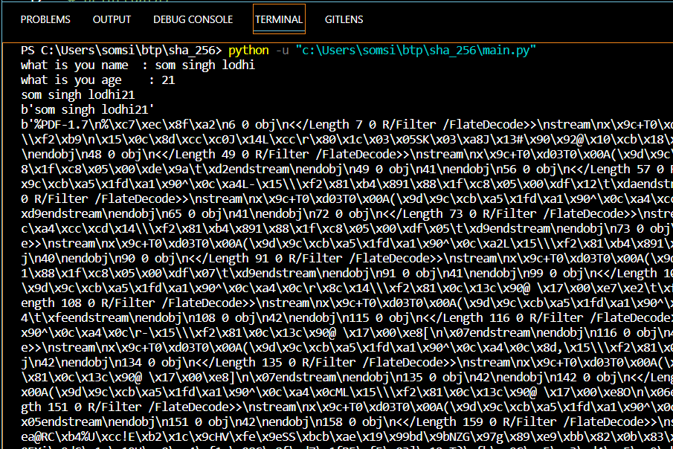
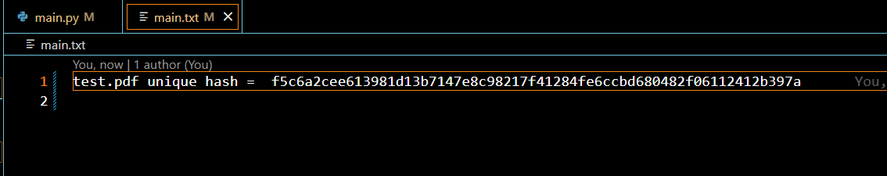

Slide 14
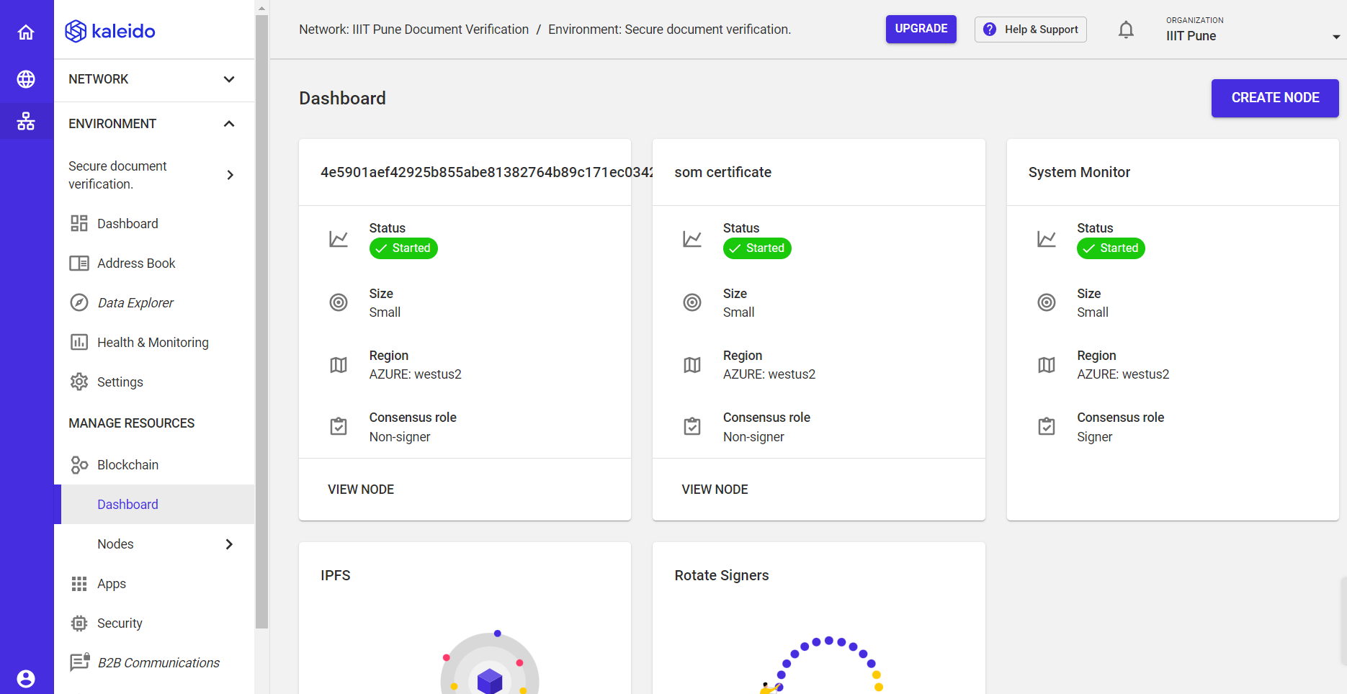

Slide 15
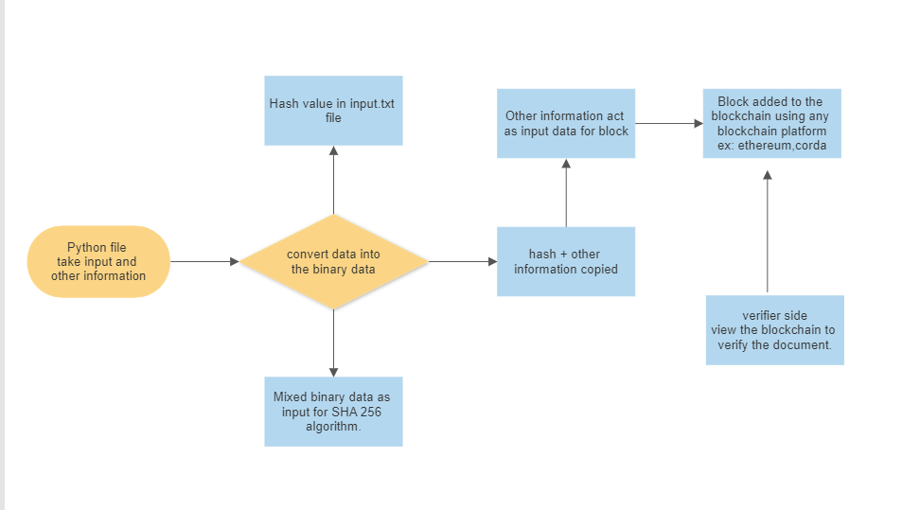
Activity Diagram of working model

Slide 16
Drawbacks of the model
It's not automatic; finding the path to the file and converting it to binary data must be done manually.
Adding the file's data and generated hash to the block also must be done manually.
Adding the block to the blockchain is a slow and time-consuming process.
Additional information:
The free version of Corda is limited to only allowing two nodes in a blockchain network.

Slide 17
Future Scope
Making every process automatic to improve efficiency.
Utilizing web development to host the site and make the technology easily accessible for everyone.
Switching to the Ethereum blockchain and smart contracts instead of Corda.
Allowing for an unlimited number of nodes, rather than being limited to only two.

Slide 18
Name: Som Singh Lodhi
Academic Year: 2nd Year
College: Indian Institute of Information Technology, Pune
MIS No.: 112115157

